Slide 1
KRCS HR Staff Meeting December 2025

Slide 2
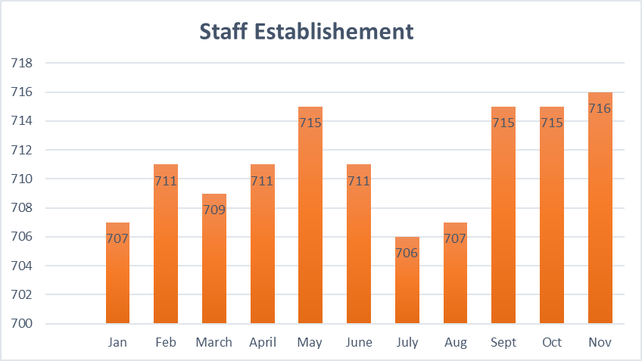
Headcount

Slide 3
Joiners
Mohamed Abdi Sheikh-DRR Project Officer
Elizabeth Juddy Chebet-Finance Assistant
Diyad Mowlid Hujale-DRR Manager-Livestock
Hassan Ali Jamaldin-Finance Assistant-KRCTI
Dinah Chepkemei Nyorsok-DRR Project Officer

Slide 4
Leavers
Jamal Hassan-Head of Islamic Financing and Philanthropy
Mohamed Mogow Mohamed-Health Project Officer-Dadaab
Dennis Kalasa Were-Health Project Officer-Kalobeyei
Abdiwahab Ismail Abdi-DRR Project Assistant-Coast
Geoffrey Ejem Lorot-Clinical-Officer-Kalobeyei
Madina Gwiye Said-DRR Project Officer-Coast
Abdikarim Ahmed Boruka-Nursing Officer-Dadaab
Lochoman Ethuron Clinical Officer-Dadaab

Slide 5
HR Pointers
As we approach the end of the year, we request that staff utilize their annual leave days to avoid December coverage issues – Supervisors and Sector heads should strictly implement and plan leave in their respective docket. No carry over days.
All staff appraisals were due by 28th November 2025. So far only West Kenya and North Eastern Regions have submitted their appraisals.

Slide 6
HR Pointers-Highlight of 2025
As we approach the end of the year, we want to reflect on some of the highlights of the year. Our main objective this year was to enhance physical and mental well-being for all our employees.
Monthly wellness online webinars and talks done in conjunction with the health department and Jubilee Health insurance.
Men’s wellness meetings and online webinars.
Financial wellness talk that was conducted in conjunction with Standard Chartered bank.

Slide 7
Thank
You

